Slide 1

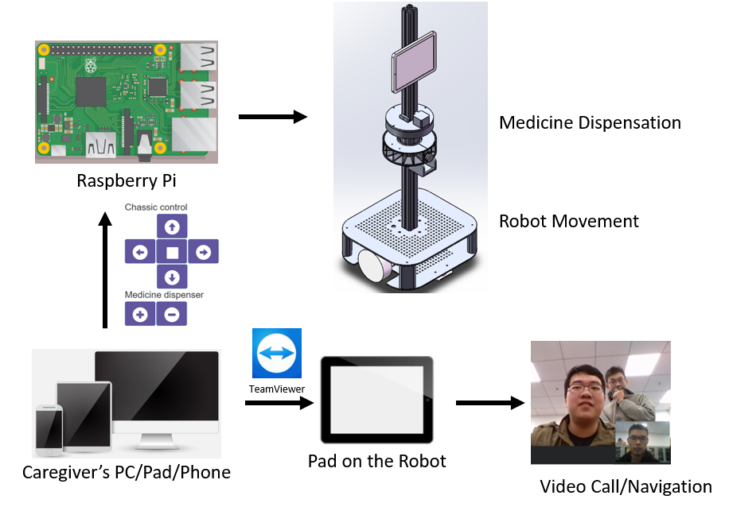
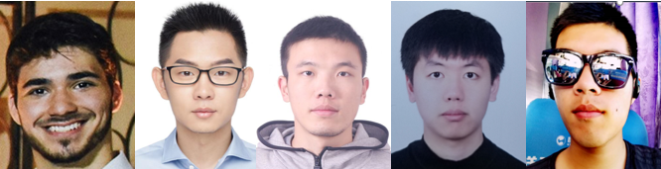
Capstone Design
Team 14: Healthcare Telepresence Robot for Elderly
老人用远程护理机器人
Be controlled remotely by caregivers through PC or mobile devices with high stability and navigation
Dispense medicine for the elderly with alarm
Provide stable video communication between caregivers and elderly to improve emotional feeling

